Slide 1

Databases
Lesson 12
SQL User Defined Functions
1

Slide 2
User Defined Functions (UDF)
In-built functions in SQL Server are not enough to use in applications with different business logics, complex algorithms, calculations and custom actions.
UDFs were introduced with SQL Server 2000, to create own routines, which can accept parameters, perform custom actions and return results.

Slide 3
User Defined Functions (UDF)
UDFs allow modular programming and faster execution.
– Can create the function once, store it in the database, and call it any number of times in the program.
UDFs can be used to perform a complex logic, can accept parameters and return data.
Has the ability to use UDFs anywhere.

Slide 4
Types of UDFs
Scalar Functions
Return a Scalar/Single value.
Table-Valued Functions
The function which returns a row set of SQL Server Table data type.
Return a table.
Inline Table-Valued
Multi-Statement Table-Valued

Slide 5
UDF Syntax
CREATE FUNCTION <function name> (<parameters>)
RETURNS <return type>
AS
BEGIN
<function body>
RETURN <return value>
END
Execute Function
SELECT <function name> (<parameter value>)

Slide 6
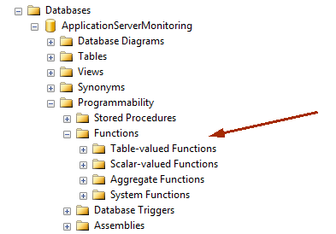
UDF

Slide 7
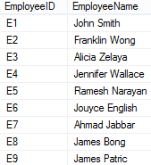
Scalar Function
Create a function to display employee name when EmpID is entered to the function.

Slide 8
Scalar Function
CREATE FUNCTION Find_Name (@id char (4))
RETURNS varchar(50)
AS BEGIN
DECLARE @name varchar(50)
SELECT @name = EmployeeName FROM Employee
WHERE EmployeeID = @id
RETURN @name
END

Slide 9
Scalar Function
CREATE FUNCTION Find_Name (@id char (4))
RETURNS varchar(50)
AS BEGIN
RETURN (SELECT EmployeeName
FROM Employee
WHERE EmployeeID = @id)
END

Slide 10
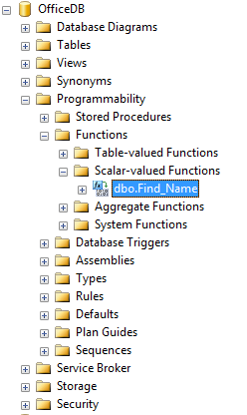
Execution of a Scalar Function
Display the name of E1 employee.

Slide 11


Execution of a Scalar Function
SELECT dbo.Find_Name(‘E1’)
SELECT dbo.Find_Name(‘E1’) AS [Employee Name]
SELECT dbo.Find_Name(‘E1’) AS ‘Employee Name’

Slide 12
Inline Table-Valued Function
Returns a variable of data type ‘table’ whose value is derived from a single SELECT statement.
Returns a result set, as opposed to a single scalar value.
Specifies the TABLE keyword in its RETURN clause.
Specifies only RETURNS TABLE and not the table definition. The entire select query inside the function is a single RETURN statement.
It is a good alternative to a VIEW type logic with parameters.
VIEW does not allow parameters
‘Parameterized Views’

Slide 13
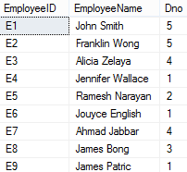
Inline Table-Valued Function
Create a function to display EmployeeID, Name and DeptNo when EmpID is entered to the function.

Slide 14
Inline Table-Valued Function
CREATE FUNCTION Emp_Details (@EmpID char (4))
RETURNS TABLE
AS RETURN
(SELECT EmployeeID, EmployeeName, Dno FROM Employee
WHERE EmployeeID = @EmpID)

Slide 15

Execution of In-Line Table Valued Function
Display the details of E1 employee.
SELECT * FROM Emp_Details (‘E1’)

Slide 16
Inline Table-Valued Function
CREATE FUNCTION All_Emp_Details (@Dno int)
RETURNS TABLE
AS RETURN
(SELECT EmployeeID, EmployeeName, Dno FROM Employee
WHERE Dno = @Dno)

Slide 17

Execution of In-Line Table Valued Function
Display the details of employees working in department 1.
SELECT * FROM All_Emp_Details (1)

Slide 18
Multi-Statement Table-Valued Function
Returns a temporary table, specifying the fields, data type etc.
It can have one or more SQL statements.
The scope of that temporary table is limited to the UDF in which it was defined, so when the UDF ends, the temporary table disappears too.
Used when need to perform extra data manipulation on SELECT data like INSERT, UPDATE, DELETE or any filtering - before inserting the final output into Table Variable.
Also used when need to perform some complex logic on input
parameter before using it in WHERE clause.

Slide 19
Multi-Statement Table-Valued Function
CREATE FUNCTION Dept_Emp_Details (@DeptID int)
RETURNS @Dept_Emp TABLE
(EmpID char(4), Name varchar(50))
AS BEGIN
INSERT INTO @Dept_Emp
SELECT EmployeeID, EmployeeName FROM Employee
WHERE Dno = @DeptID RETURN
END

Slide 20

Execution of Multi-Statement Table-Valued
Function
Display the details of employees working in department 1.
SELECT * from Dept_Emp_Details (1)

Slide 21
Thank You
21

